Slide 1

Huazhong University of Science and Technology
The Department of Electronics and Information Engineering
Electronic Circuit Analysis and Design
Dr. Tianping Deng
Email: dengtp@hust.edu.cn

Slide 2
Contents
PART 1 SEMICONDUCTOR DEVICES AND BASIC APPLICATIONS
Chapter 1 Semiconductor Materials and Diodes
Chapter 2 Diode Circuits
Chapter 3 The Field-Effect Transistor
Chapter 4 Basic FET Amplifiers
Chapter 5 The Bipolar Junction Transistor
Chapter 6 Basic BJT Amplifiers
Chapter 7 Frequency Response
Chapter 8 Output Stages and Power Amplifiers
PART 2 ANALOG ELECTRONICS
Chapter 9 Ideal Operational Amplifiers and Op-Amp Circuits
Chapter 10 Integrated Circuit Biasing and Active Loads
Chapter 11 Differential and Multistage Amplifiers
Chapter 12 Feedback and Stability
Chapter 13 Operational Amplifier Circuits
Chapter 14 Nonideal Effects in Operational Amplifier Circuits
Chapter 15 Applications and Design of Integrated Circuits
Chapter 12 Feedback and Stability

Slide 3
Ch12 Feedback and Stability
12.0 Preview
12.1 Introduction to Feedback
12.2 Basic Feedback Concepts
12.3 Ideal Feedback Topologies
12.4 voltage (Series-Shunt) Amplifiers
12.5 Current (Shunt-Series) Amplifiers
12.6 Transconductance (Series-Series) Amplifiers
12.7 Transresistance (Shunt-Shunt) Amplifiers
12.8 Loop Gain
12.9 Stability of the Feedback Circuit
12.10 Frequency Compensation
12.11 Summary

Slide 4
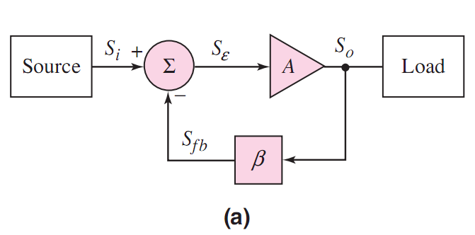




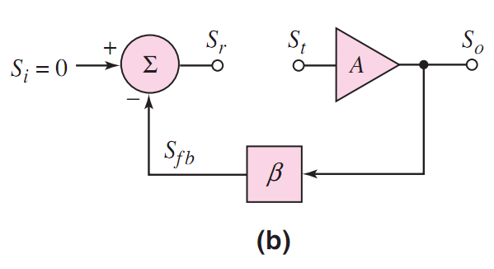




Slide 5






Slide 6

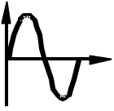
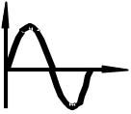


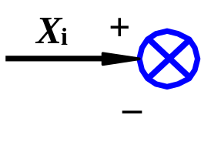
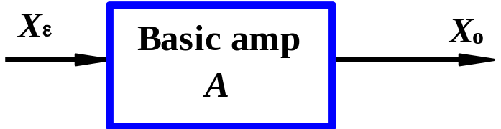
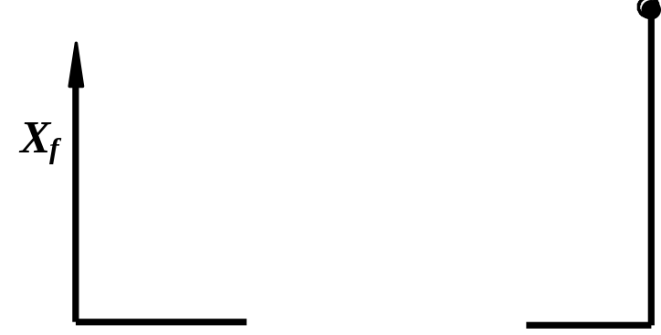
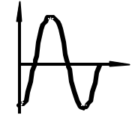
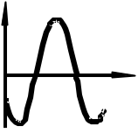
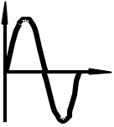




The Stability Problem
1. Oscillation
If |T|=1, ϕ=180°,
Then T(jω)=−1.
Output exists for a zero input.
Circuit will oscillate.
2. Reason
When phase of T(jω) is 180° at high- or low freq. Negative feedback becomes positive. If |T(jω)|=1, circuit is unstable.

Slide 7
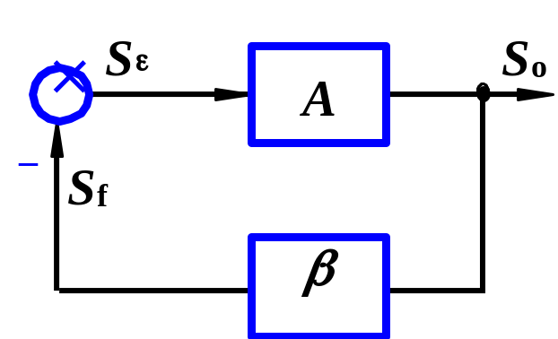
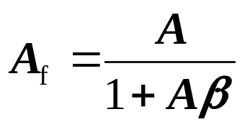
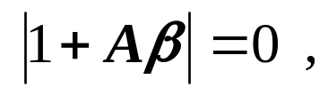
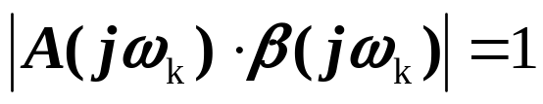
3. Oscillating Condition
Closed-loop
When
Circuit will oscillate
That is , T(jω)= −1
Oscillating Condition
Magnitude condition
Phase condition
The phase of (-1) in comparator doesn't include in Δ ϕ.

Slide 8
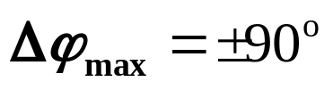
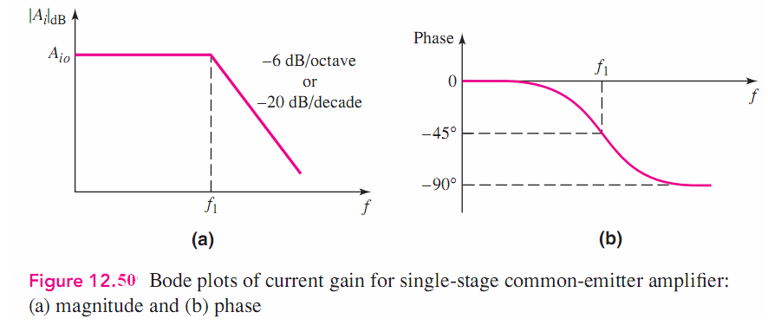
3. Oscillating Condition
Single-stage circuit
Circuit is stable.

Slide 9
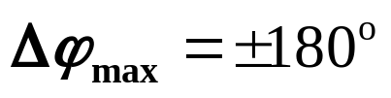
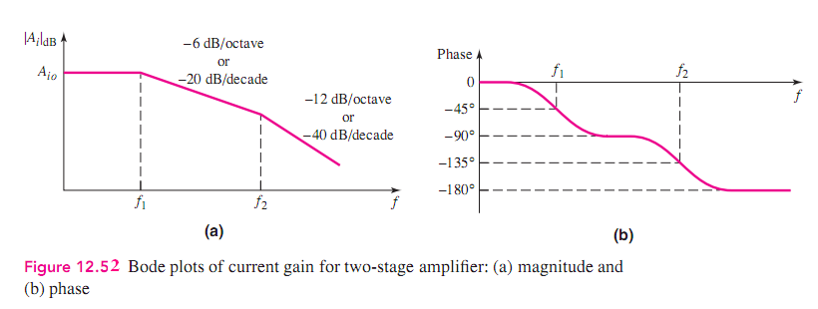
3. Oscillating Condition
Two-stage circuit
But |T(jω)|=0.
Circuit is stable.

Slide 10
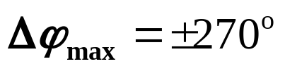
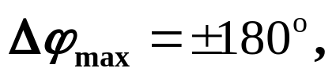
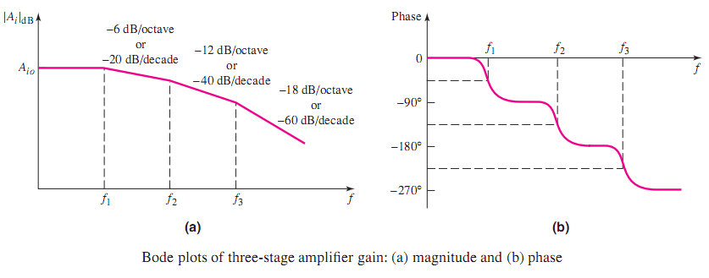
3. Oscillating Condition
Three-stage circuit
At some frequency
Phase difference
and |T(jω)|=1,
Circuit is unstable. (P295 figure 12.54)

Slide 11
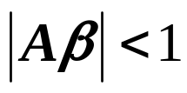
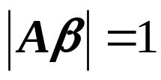

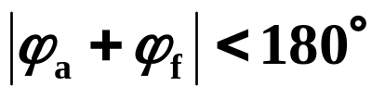
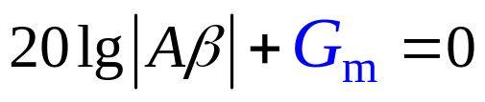
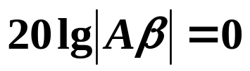
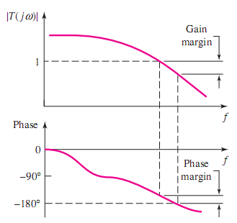

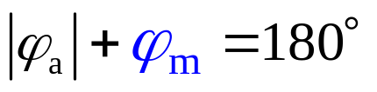
12.9.4. Phase and Gain Margins
When
or
Circuit is stable.
If feedback network is resistor. Use logarithmic scales.
Where
G_{m}—Gain margin，generally G_{m} ≤ - 10dB
ϕ_{m}—Phase margin，generally ϕ_{m} ≥ 45°

Slide 12
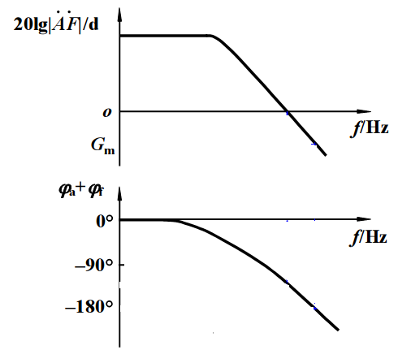
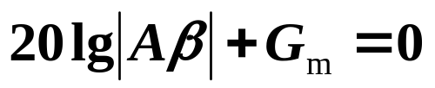


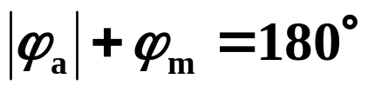
12.9.4. Phase and Gain Margins
G_{m} ≤ -10dB or ϕ_{m} ≥ 45°

Slide 13
Questions
and
Answers

